Slide 1

AASD 4004
Machine Learning - II
Applied AI Solutions Developer Program

Slide 2
Module 12 Edges
Contours
Shapes
Vejey Gandyer

Slide 3
Agenda
Edge
Laplacian
Sobel
Canny
Contours
Watershed
Shapes

Slide 4
Edges in Images
What is it?

Slide 5
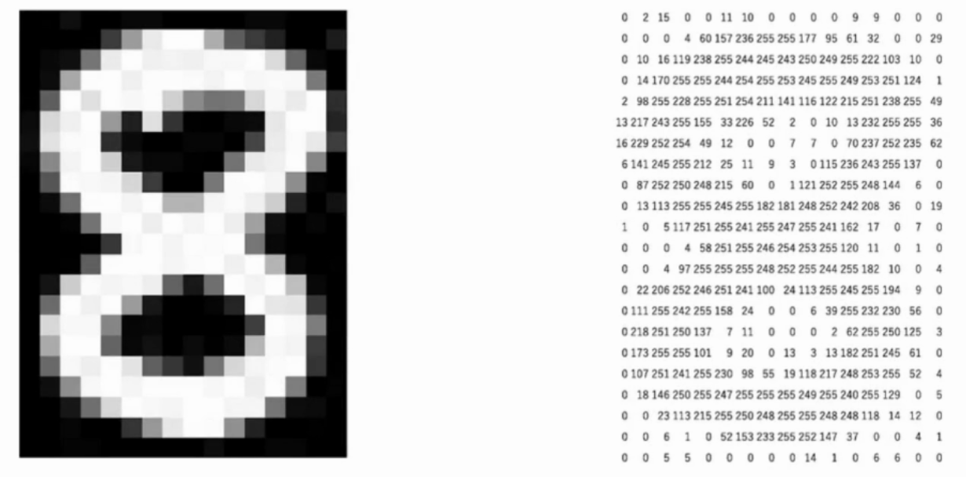
Edges
Edge detection is the process of finding boundaries of objects in an image
Edges = Points where brightness of pixel intensities changes drastically

Slide 6
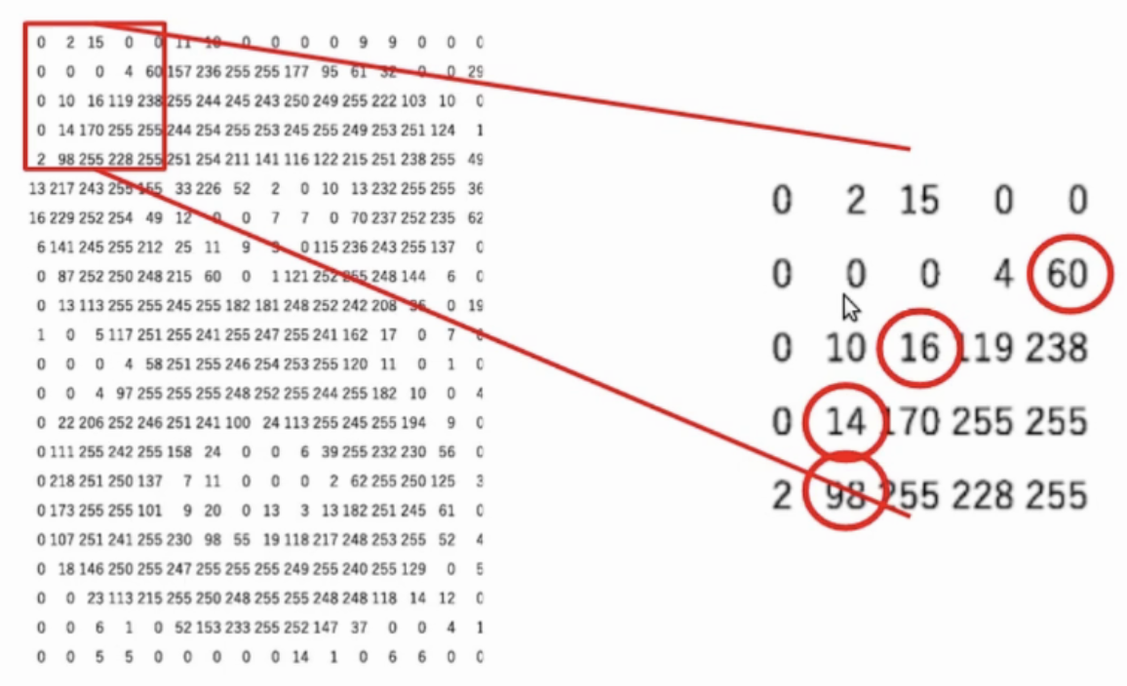
Edge or No edge

Slide 7
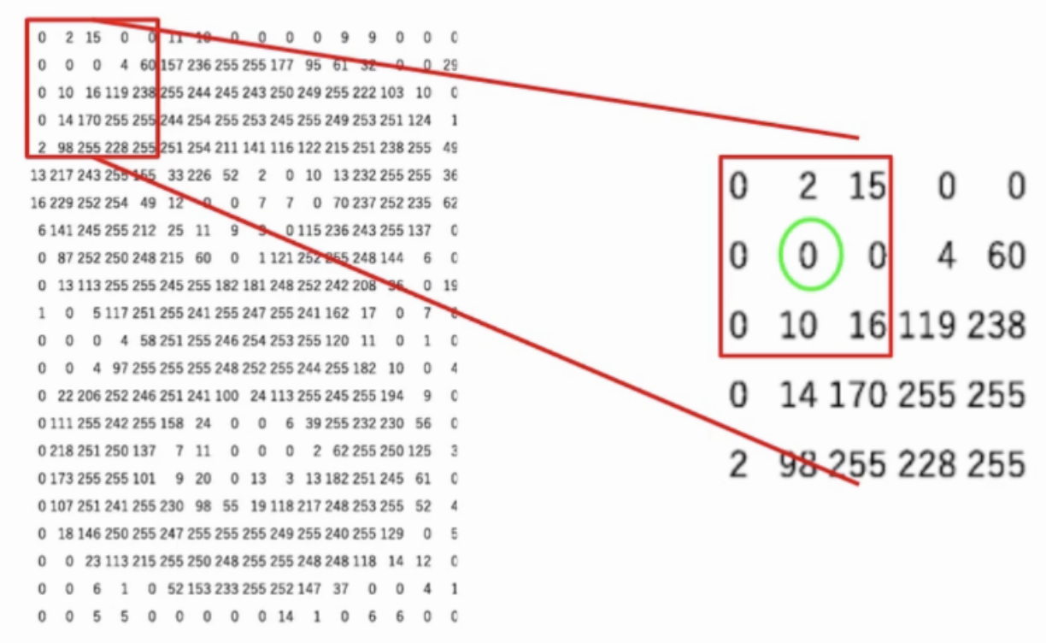
Edge or No edge

Slide 8
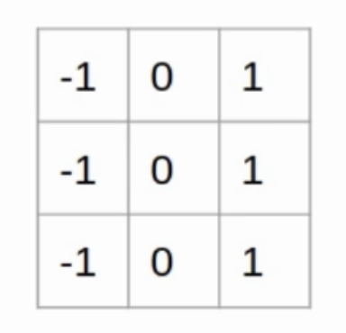
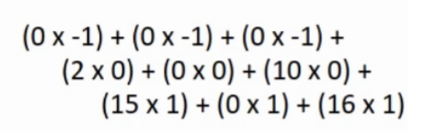
Edge or No edge

Slide 9
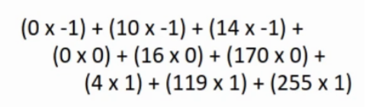
Edge or No edge

Slide 10
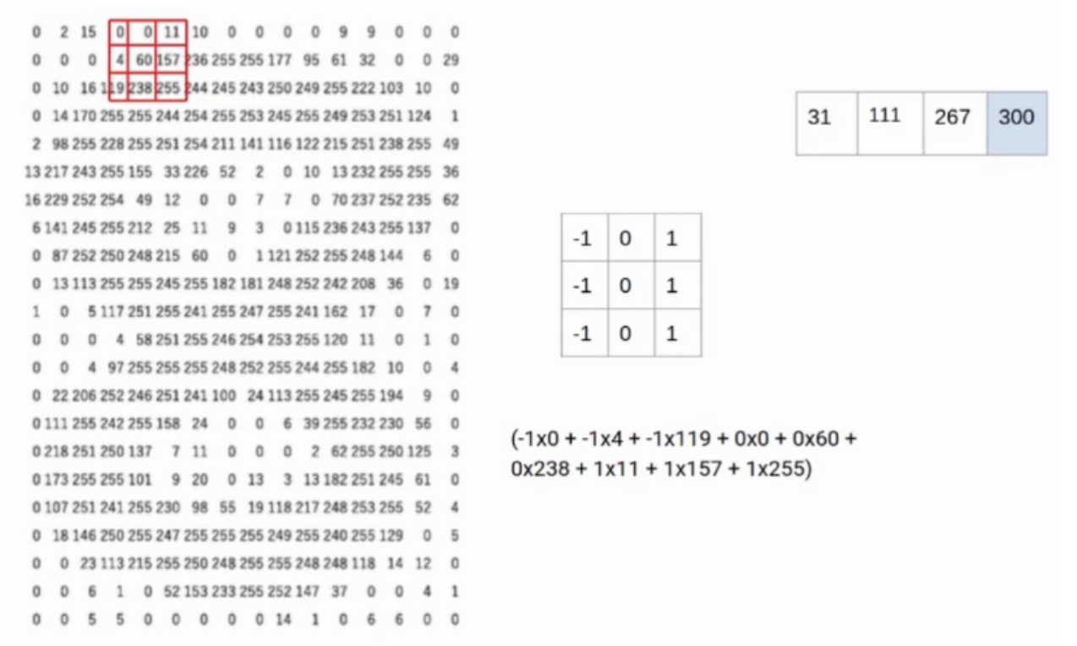
Edge Detection process

Slide 11
Types of Edge Detection Algorithms
Types
- Laplacian
- Sobel
- Canny

Slide 12
Laplacian
Laplacian edge detection computes gradients
Laplacian( image, CV_64F )

Slide 13
Sobel
Sobel edge detection computes gradient magnitude representations along the x and y axis and then combines both the vertical edges and horizontal edges
Sobel( image, CV_64F, order of derivatives )

Slide 14
Canny
Canny edge detection is a multi-step process
Blur the image to remove noise
Compute Sobel gradient images in the x and y direction
Suppress edges
Hysteresis thresholding stage that determines if a pixel is "edge-like" or not
Canny( image, non-edge_threshold, edge_threshold )

Slide 15
Contours
What is it?

Slide 16
Contours
A contour is a curve of points, with no gaps in the curve
To find contours in an image:
Edge detection
Thresholding
findContours( )

Slide 17
findContours( )
image
Types of contour
cv2.RETR_EXTERNAL
cv2.RETR_LIST
cv2.RETR_COMP
cv2.RETR_TREE
approximation of contour
cv2.CHAIN_APPROX_SIMPLE
cv2.CHAIN_APPROX_NONE
Returns a tuple
output image after applying contour detection
cnts list of contours detected
hierarchy of the contours

Slide 18
Watershed
What is it?

Slide 19
Watershed
Classic algorithm used for segmentation and is especially useful when extracting touching or overlapping objects in images
When utilizing the watershed algorithm we must start with user-defined markers
These markers can be either defined:
manually point-and-click
automatically or heuristically define them
thresholding operations
morphological operations

Slide 20
Segment & Extract Objects
Import the libraries
Load the image
Apply Pyramid Mean Shift Filtering
Convert the image into grayscale
Threshold the Mean Shifted image
Detect Contours using findContours()
Draw Contours using drawContours()
Display the extracted contours

Slide 21
Shapes
What is it?

Slide 22
Shape detection
Find contours of objects
Find centers of each object
Recognize shapes of each object
Circle
Square
Rectangle
Triangle
Pentagon
Label color of a shape

Slide 23
Shape detection
Contour Approximation
Algorithm for reducing the number of points in a curve with a reduced set of points
Assumption: A curve can be approximated by a series of short line segments
cv2.approxPolyDP()
contour
1-15% of contour perimeter
Shape analysis
If vertices are 3 in the contour
Traingle
If vertices are 5 in the contour
Pentagon
If vertices are 4 in the contour
If aspect ratio is between 0.95 to 1.05
Square
If aspect ration is skewed
Rectangle

Slide 24
Further Reading
Digital Image Processing 4th edition
Rafael Gonzalez & Richard Woods

